Slide 1
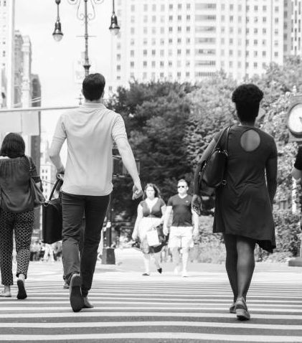
REAL-TIME FACEMASK DETECTION (CORONAVIRUS)
- Ashish Agarwal

Slide 2
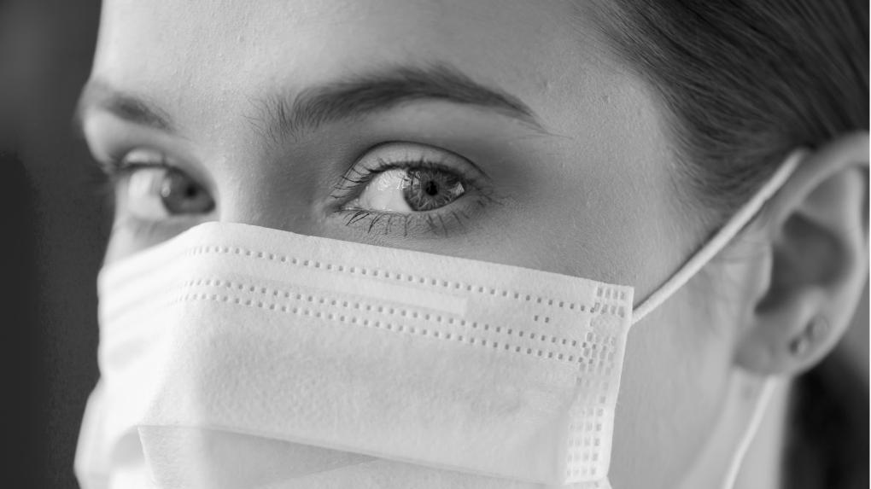
HELLO!
Even though we are living a difficult time, our future is still bright

Slide 3
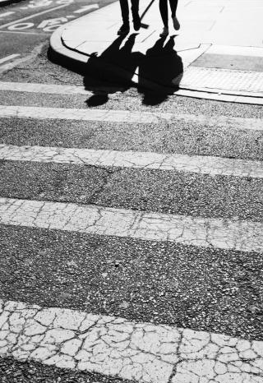
TABLE OF CONTENTS
01
02
03
Introduction
Presentation
Conclusion

Slide 4
THE PANDEMIC
1,69,78,206
9,916,230
6,66,239
Let’s refresh our memory with some general data about the virus
Worldwide cases
Deaths
Recovered

Slide 5
GENERAL VIEWS
Positive
01
Negative
02
Evolution of healthcare, new and better habits, reduction of inequality
These two trends will tell us what’s to come and what to expect
Harsher surveillance, divide between countries, economic recession

Slide 6
CHANGES IN SOCIETY
01
How some global topics will evolve in time

Slide 7
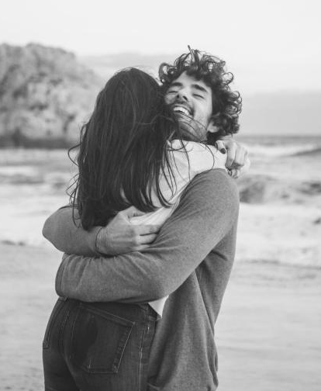
—Helen Keller,
American author and political activist
“
Optimism is the faith that leads to achievement. Nothing can be done without hope and confidence”

Slide 8
TECHNOLOGY
Cloud Capacity
Machine Learning
Virtual Experience
Desktop Computers
It’s an essential means for a remote, home-based workforce
This is a powerful tool that can help us understand the disease
VR tech allows people to travel and communicate while at home
They will become more useful for workers than smartphones

Slide 9
ECONOMY
01
02
03
Recession
Mindset
Trade
We may be facing a recession in the future due to the long lockdown
We’ll start viewing our resources as things we need for living rather than items to be consumed
We’ll have to rely less on global trade and more on our own resources

Slide 10
HEALTHCARE
Digital Tech
Telemedicine
Home Testing
Using technology like AI, chatbots, voice search or VR
Remote medical assistance via computer
Using home test kits and consulting doctors without leaving home

Slide 11
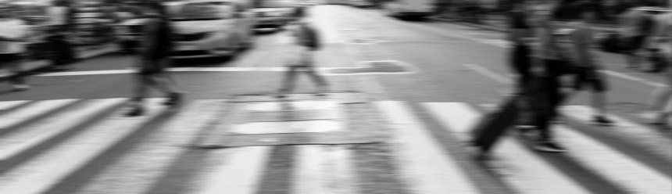
REDUCED INEQUALITY
There is an effort to help workers in the informal sector. If these policies persist after the outbreak, this will help reduce inequality

Slide 12
EDUCATION
Online Learning
5G
Coalitions
Digital Division
Done via interactive app or live online classes
It will become a more prevalent system in some countries
Companies will unite to help with a better education
Less digital-savvy families could be left behind

Slide 13
BLACK SWAN THEORY
This is a cataclysm that has caused great economic hardship and that could not have been foreseen
Policymakers can therefore use the data from this crisis to plan for future crises
Companies should learn from what has worked best and make it part of their values permanently

Slide 14
CHANGES IN OURSELVES
02
Our own habits and values will change too

Slide 15
LIFE AND VALUES
Family Time
New Habits
01
02
03
04
Slow Life
Creativity
Families will now be able to spend more time together
More creativity and freedom translates into innovation
With the new routine comes a more relaxed way of living
More time to play means an increase in creativity

Slide 16
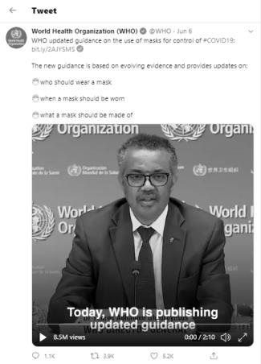
Need to get masked !!
The World Health Organization said that new information showed that protective masks could be a barrier for potentially infectious droplets. The coronavirus primarily spreads through the transmission of respiratory droplets from infected people.
On 5th day of June changed its guidelines about the use of protective face masks in public, saying that they must be worn at all places where physical distancing is not possible. The global health body had said in April that there was not enough evidence to show that healthy people should wear masks to shield themselves from the coronavirus.
WHO also said that high-risk groups should wear medical grade masks in cases where physical distancing is not possible. Several countries, including India, have made wearing masks in public compulsory. In many states, people have been fined for not wearing masks. Maintaining hygiene and using protective equipment has become even more important ahead of the reopening of religious places, malls and restaurants in India from next week.

Slide 17

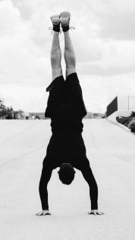
OVERVIEW
This is a simple image classification project trained on the top of Keras/Tensorflow API with MobileNetV2 deep neural network architecture having weights considered as pre-trained 'weights. The trained model takes the real-time video from webcam as an input and predicts if the face landmarks in Region of Interest (ROI) is 'Mask' or 'No Mask' with real-time on screen accuracy.

Slide 18
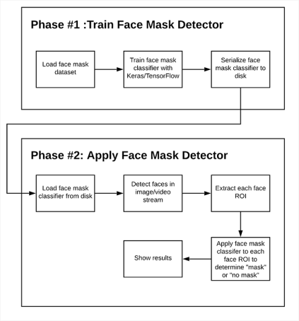
METHODOLOGY
In order to train a Face Mask Detector, we need to break our project into two distinct phases, each with its own respective sub-steps:
Training: Here we’ll focus on loading our face mask detection dataset from disk, training a model (using Keras/TensorFlow) on this dataset, and then serializing the face mask detector to disk
Deployment: Once the face mask detector is trained, we can then move on to loading the mask detector, performing face detection, and then classifying each face as with_mask or without_mask

Slide 19
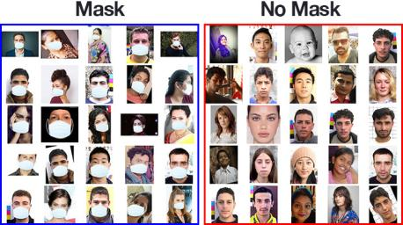
DATA SOURCE
Data input in this project are images (with_mask and without_mask). Its easily available in Kaggle and if not able to find your custom dataset, we could generate our own dataset by constructing a face mask animation over the facial landmarks where the masks are usually gets wore.

Slide 20
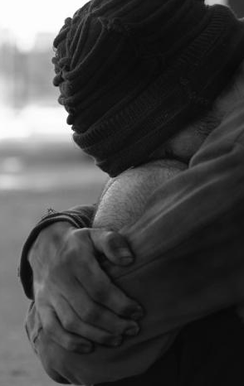
DATA AUGMENTATION
Data Augmentation
Image Processing
Translations
Rotations
Changes in Scale
Shearing
Horizontal flips
Mean Subtraction
Scaling
Image Blobbing

Slide 21
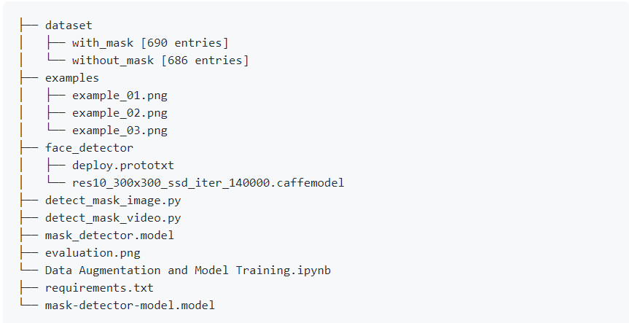
Project Structure

Slide 22
Important Scripts
Data Augmentation and Preprocessing.ipynb: In this notebook Accepts our dataset is taken as input and fine-tuning is done with MobileNetV2 DNN architecture upon it to create our mask-detector-model. model. A training history evaluation.png containing accuracy/loss curves is also produced for better visualization of Model Evaluation through a plot. Some important processes which we performed here:
Data augmentation
Loading the MobilNetV2 classifier (fine-tune this model with pre-trained ImageNet weights)
Building a new fully-connected (FC) head
Pre-processing
Loading image data
detect_mask_from_webcam.py: Using your webcam, this script applies face mask detection to every frame in the stream using webcam to read the real-time video. Some command line arguments in this script include:
--image: The path to the input image containing faces for inference
--face: The path to the face detector model directory (we need to localize faces prior to classifying them)
--model: The path to the face mask detector model that we trained earlier in this tutorial
--confidence: An optional probability threshold can be set to override 50% to filter weak face detections

Slide 23
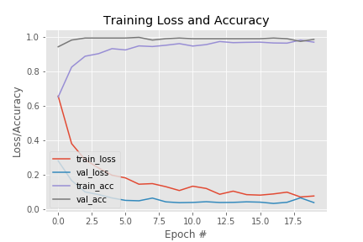
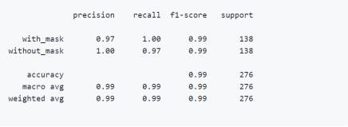
Results

Slide 24
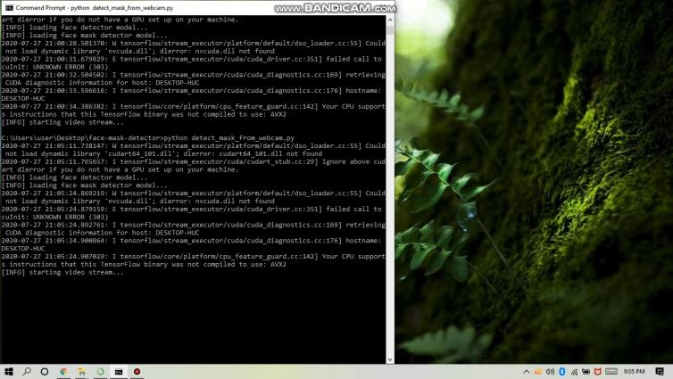
Demo

Slide 25
Resources
https://www.who.int/publications/i/item/advice-on-the-use-of-masks-in-the-community-during-home-care-and-in-healthcare-settings-in-the-context-of-the-novel-coronavirus-(2019-ncov)-outbreak
https://www.pyimagesearch.com/2018/09/10/keras-tutorial-how-to-get-started-with-keras-deep-learning-and-python/
http://www.image-net.org/
https://arxiv.org/abs/1801.04381

Slide 26


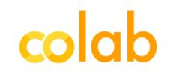



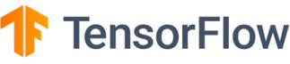
Technologies used

Slide 27
SOCIAL LIFE
Through Tech
In-person
Video calling
Texting
Online games
HOW WILL WE CONNECT?
One to one
Small gatherings
Keeping distance

Slide 28
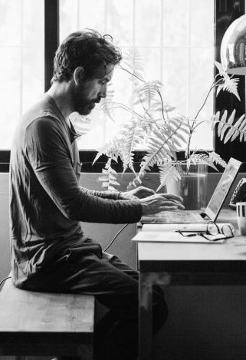
EVERYDAY HABITS
There will be more hand sanitizer available in public spaces
More companies will allow employees to work remotely
People will take their personal space more seriously
We may have a better understanding of public-health ethics
Schools and universities will be more prepared for distance learning

Slide 29
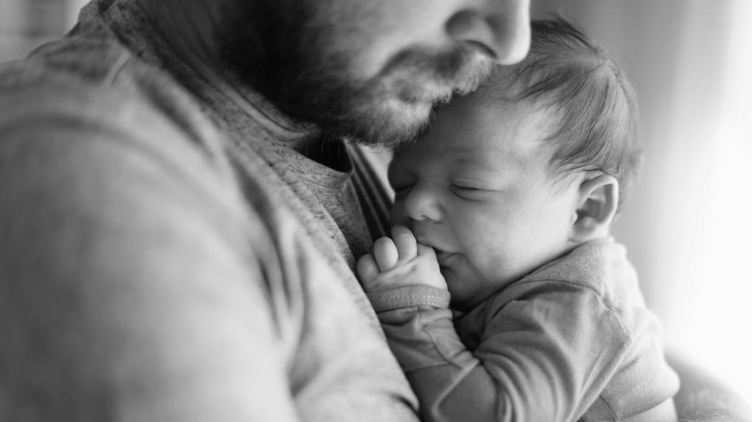
Home Sweet Home

Slide 30
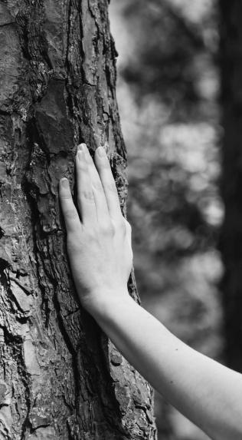
We’ll Get Through This

Slide 31

THANKS!
Do you have any questions?
+91 904 020 0202
https://github.com/ikigai-aa
ashish18agarwalla@gmail.com
https://www.linkedin.com/in/aa-ikigai/

